Slide 1
THE RESULTS OF QUESTIONNARE
Emanuel Pötting’s Nursing School and Nursing College in Olomouc
Czech Republic

Slide 2
Questionnaire was completed by 40 students.
9 Males – 22,50%
31 Females – 77,50%

Slide 12
10. Men and women usually share household chores in my society.

Slide 20
Summary
Boys and girls have equal opportunities in our school.
Homophobic incidents (e. g. name calling, bullying etc) are very rare in our school.
Students are confident that our school would deal effectively with a homophobic incident.

Slide 21
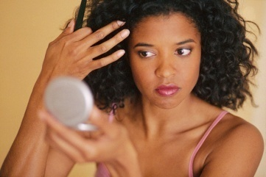
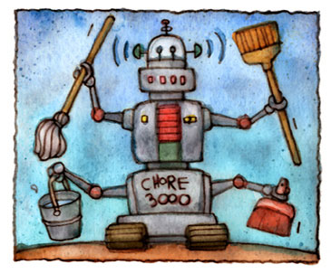
Summary
Women are as likely as men to occupy leadership roles in schools, but not in business in our country.
There is bigger pressure for girls than boys to behave in a particular way in our society.
There is more pressure on women than men in terms of physical appearance in our society.
Men and women have equal rights in our society - in practice as well as in principle.
Men and women rather don’t share household chores in our society.

Slide 22
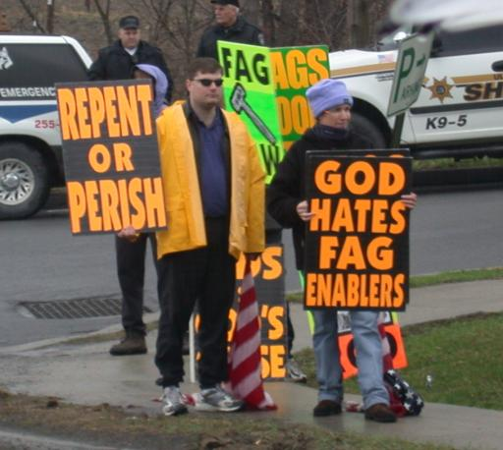
Summary
Students frequently hear words such as "gay" used in a negative way (either maliciously or as a joke).
If anyone came out as gay in our school, our peers would be very accepting.
Gay, lesbian and bisexual people have no equality with straight people in our society - in practice as well as in principle.

Slide 23
Summary
Students didn’t understand some questions.
The results are affected by majority of girls.

Slide 24
THANKS FOR WATCHING

